Slide 1


CSGE601020 | Foundations of Programming 1
Functions in Python
Fariz Darari
A video lecture using this slideset is available (+ other cool Python tutorial videos):
https://bit.ly/pymooc-id
Notes:
https://pixabay.com/photos/phone-old-year-built-1955-bakelite-3594206/

Slide 2
Remember our first Hello World program?
print("Hello, world!") # calls print() function
Notes:
Precisely: You *call* a built-in function by Python to print Hello World to the screen

Slide 3

This code also relies on functions from module math
from math import *
print(ceil(1.23))
print(pow(5,3))
print(factorial(4))
Notes:
ceil = atap = smallest integer greater than or equal to the given float number
pow = pangkat
factorial = perkalian bilangan bulat dari 1, 2, dst, sampai given number

Slide 4
Programming without functions
# compute factorial of 3
result = 1
for i in range(1,4):
result *= i
print("Factorial of", 3, "is", result)
# compute factorial of 4
result = 1
for i in range(1,5):
result *= i
print("Factorial of", 4, "is", result)
Notes:
Repeat code excessively, prone to error, if there is a mistake we must change all copies of code

Slide 5
Functions: What and why
A function is a set of instructions you can call to carry out a specific task
Benefits of functions
Avoid repeating code
Improved reliability
Improved modularity
Notes:
Reuse
As we don't repeat code, we just have to check/test one code part (for function) instead of many places
More organized/cleaner code = Break code into smaller chunks

Slide 6
Let's create a factorial function
def my_factorial(n): # function signature
# function body
result = 1
for i in range(1,n+1):
result *= i
return result
Notes:
Want to create a func for factorial
Function signature:
def keyword
func name (my_factorial)
parameter (only n, but can be more, or even no parameter)
Colon (to say that the next part is the function body)
Function body: Statements of code that run whenever the function is called! + optionally return statement
Must be indented properly
Note: Python reaches return -> Function stops and return the value

Slide 7

Let's create a factorial function
def my_factorial(n): # function signature
# function body
result = 1
for i in range(1,n+1):
result *= i
return result
Notes:
Want to create a func for factorial
Function signature:
def keyword
func name (my_factorial)
parameter (only n, but can be more, or even no parameter)
Colon (to say that the next part is the function body)
Function body: Statements of code that run whenever the function is called! + optionally return statement
Must be indented properly
Note: Python reaches return -> Function stops and return the value

Slide 8

A function with no parameters and no return
def hi():
print("Hi!")
Notes:
To be precise, it returns None (special Python value, indicating the concept of nothing)

Slide 9

Quiz time: Modify this function to say hi to some name!
def hi():
print("Hi!")

Slide 10
Quiz time: Modify this function to say hi to some name!
def hi(name):
print("Hi, " + name + "!")

Slide 11
Quiz time: What's wrong with this code?
def hi_fitri():
name = "Fitri"
print("Hi, " + name + "!")
hi_fitri()
print(name)

Slide 12
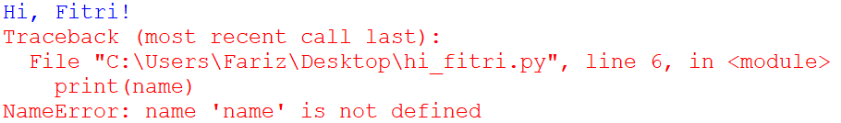
Quiz time: What's wrong with this code?
def hi_fitri():
name = "Fitri"
print("Hi, " + name + "!")
hi_fitri()
print(name)
Notes:
Variables in a function are local: Accessible only within the function

Slide 13
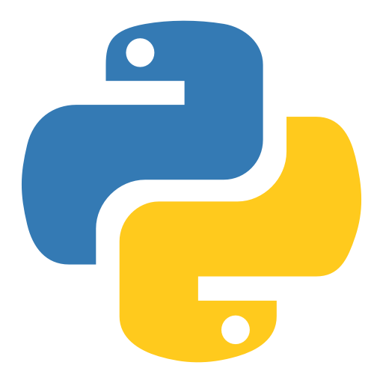
def thanks():
print("Thank you for watching!")
Notes:
https://www.iconfinder.com/icons/4375050/logo_python_icon

